Slide 1
Creating Gunslinger By Far the World's Most Fun Mixed-Reality, Multi-Agent, Story-Driven, Interactive Experience
Arno Hartholt, Kim LeMasters, Jonathan Gratch, Stacy Marsella, David Traum, Louis-Philippe Morency

Slide 2
Overview
What is Gunslinger
Related Work
Gunslinger Architecture & Technology
Design Approach
Future Work
Questions

Slide 3
Notes:
See http://ict.usc.edu/projects/gunslinger/ for movie Gunslinger.

Slide 4
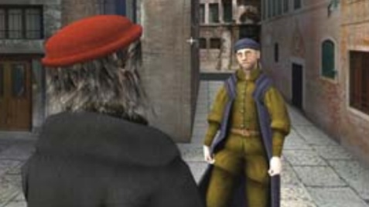
Extensive Research on Interactive Narrative
Goal-directed autonomous characters
Oz Project / Zoesis Mr. Bub (Bates; Loyall; Neal Reilly; Weyhraunch)
VICTEC / eCIRCUS (Dias & Paiva; Aylett et al)
MRE / SASO (Swartout et al.; Rickel)
Interactive story management
Madame Bovary (Cavazza et al)
Narrative Planning (Riedl & Young)
Thespian (Si & Marsella)
Façade (Mateas & Stern)
Most systems mix some element of character
autonomy with overarching story

Slide 5
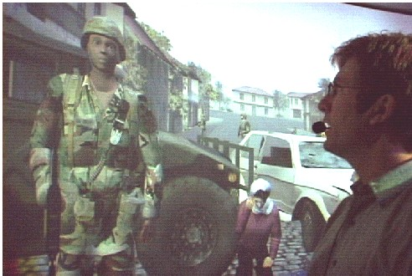
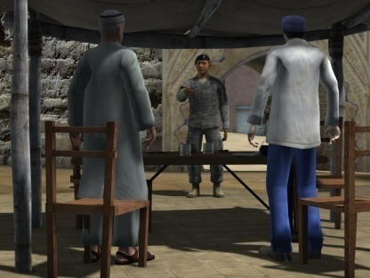
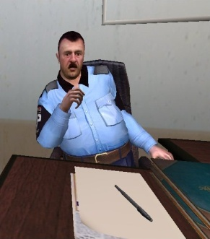
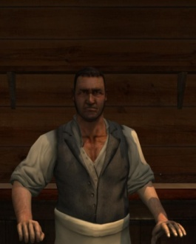
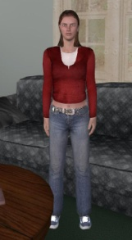
From Basic Research To Applied Projects
MRE
SASO-ST
SASO-EN
SASO-MP
Virtual Humans
Basic Research
Applied Research and Applications

Slide 6
Gunslinger Goals
Integrate and push a wide variety of research, technologies and techniques
Show that virtual humans can be engaging

Slide 7
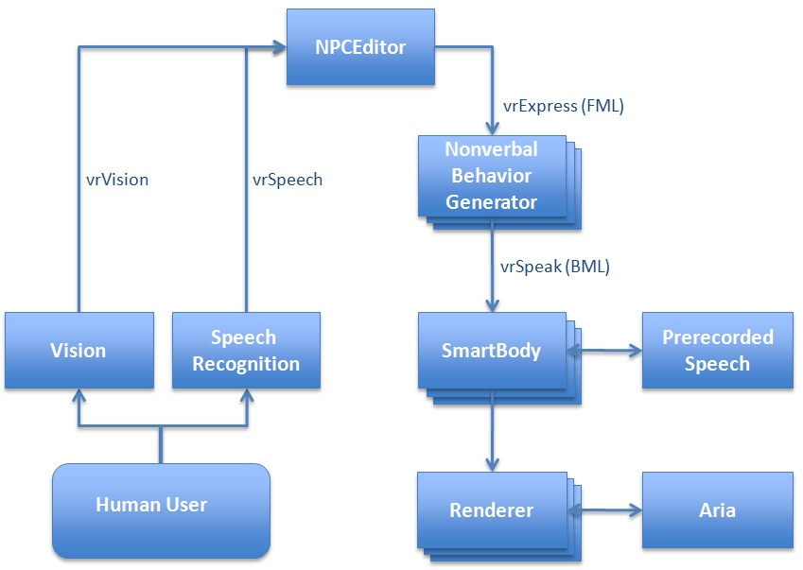
Architecture

Slide 8
Modules
Speech recognition (Naryanan et al)
Push-to-talk or continuous
Vision (Morency et al)
Facing
Distance to characters
Gun drawn
NPCEditor (Leuski & Traum)
Statistical text classifier, mapping input to output
Scripting engine
Input: speech text strings, vision information, story state
Output: character lines, sequences, story state updates

Slide 9
Modules
Nonverbal Behavior Generator
(Lee & Marsella)
Generates gazes, head nods,
selects animations
Body Markup Language (BML)
SmartBody (Thiebaux, Marshall, Marsella, Shapiro)
Realizes BML
Synchronizes nonverbal behavior with pre-recorded speech
Gamebryo (Emergent)
Rendering engine
Aria (Sadek)
Surround sound
3D localized sound through vibrating screen

Slide 10
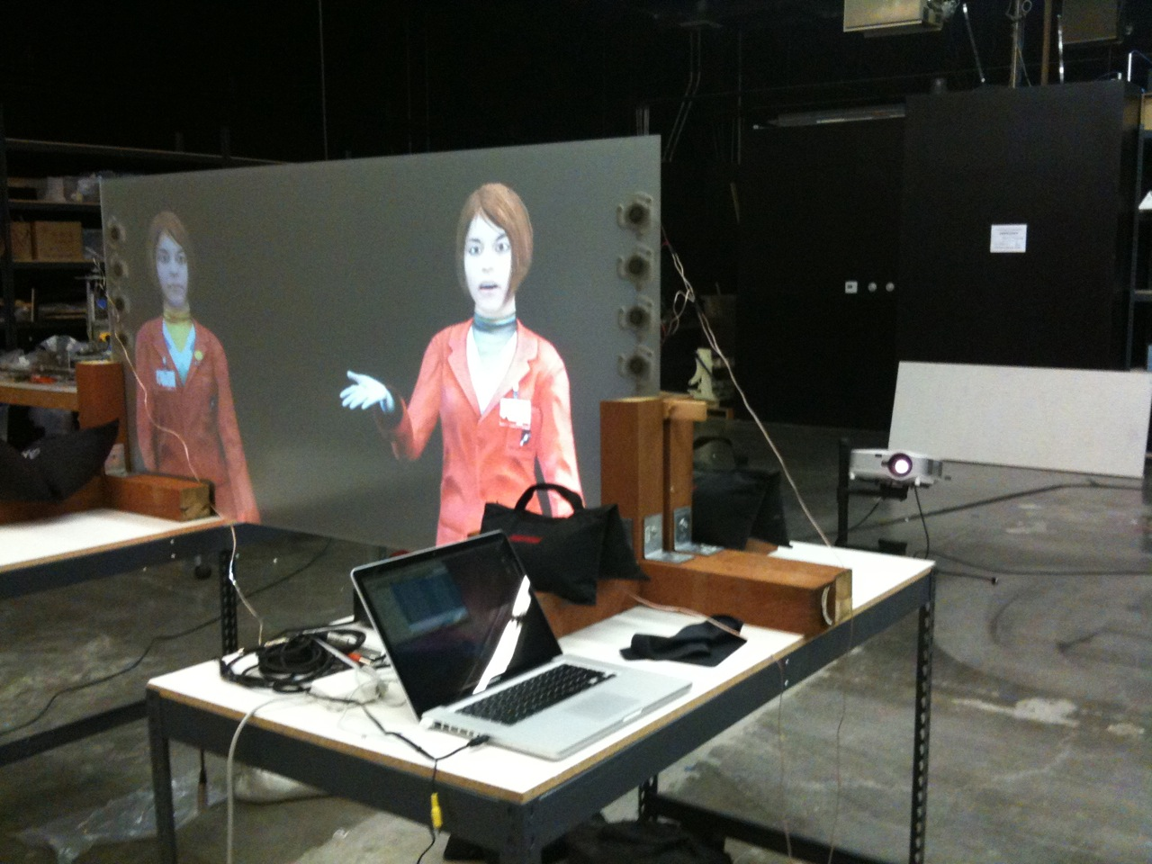
Localized Sound
Notes:
3D localized sound by resonating screen

Slide 11
Story Overview
Intro &
Smalltalk
Rio’s
Entry 1
Practice
Disengage
Ambush
Rio’s Entry 2
Rio’s Entry 2
Rio Dies
Rio & Utah Die
Ranger Dies
Rio Dies
Ranger Dies
Notes:
Classified by domains
50 domains
Three types:
Free range
Questions / choices
Sequences

Slide 12
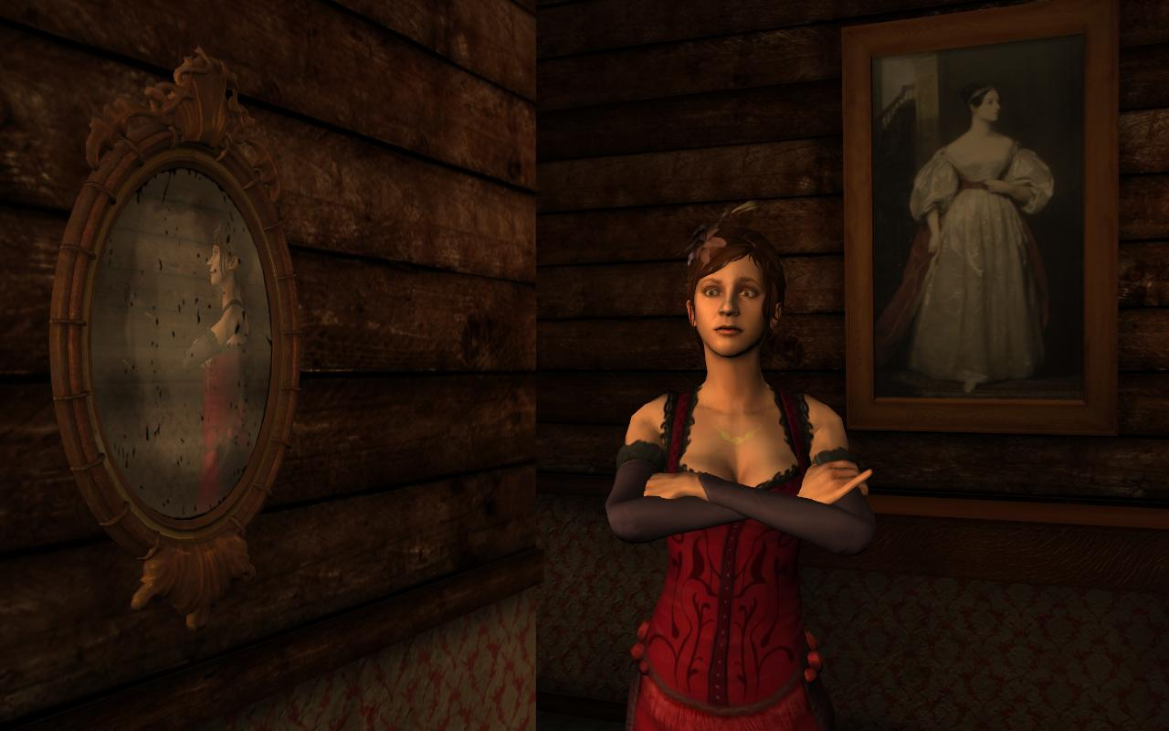
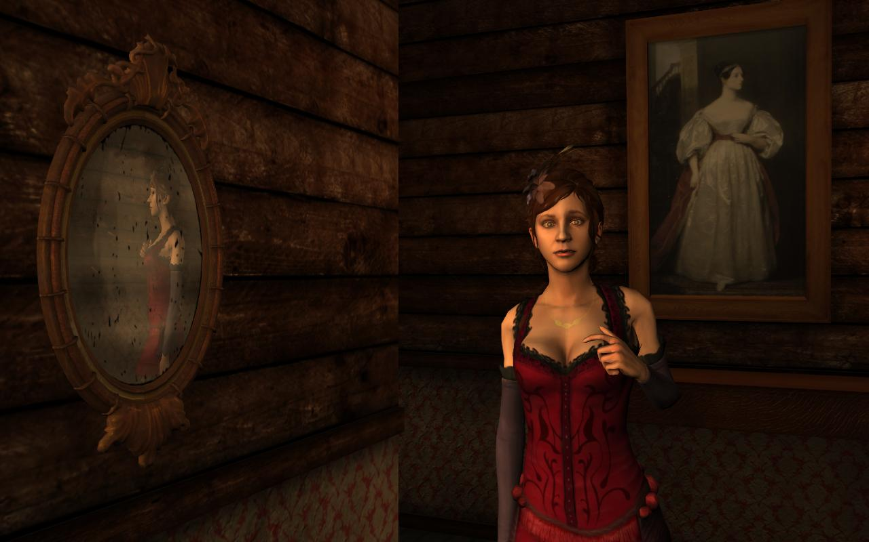
Example
Story state: utah-harmony-smalltalk
Ranger input
“What is your name?”
Facing Harmony
Response
Harmony: “My name is Harmony.”
No state change

Slide 13
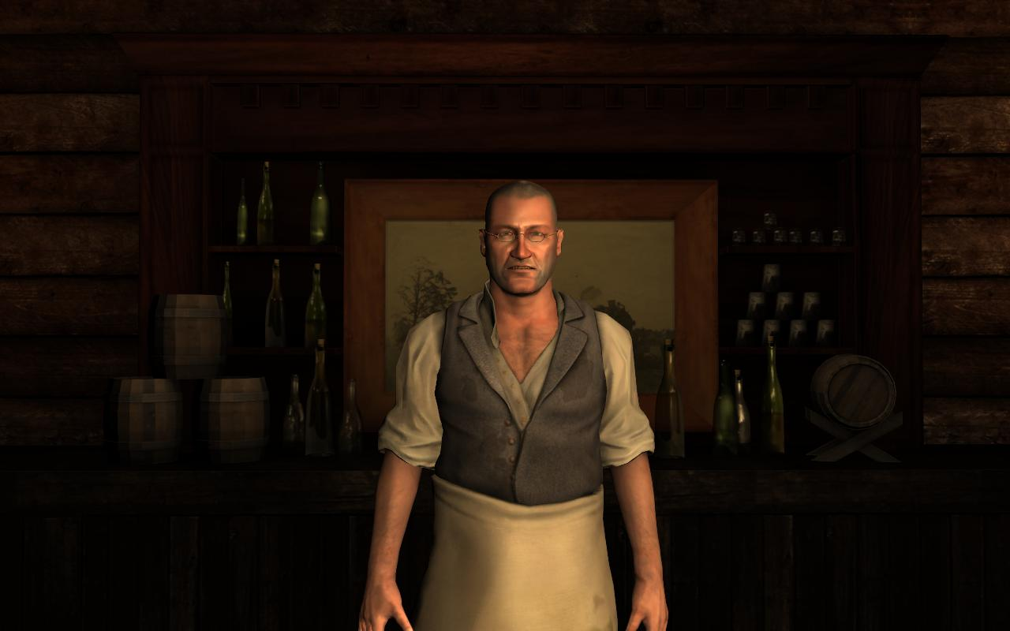
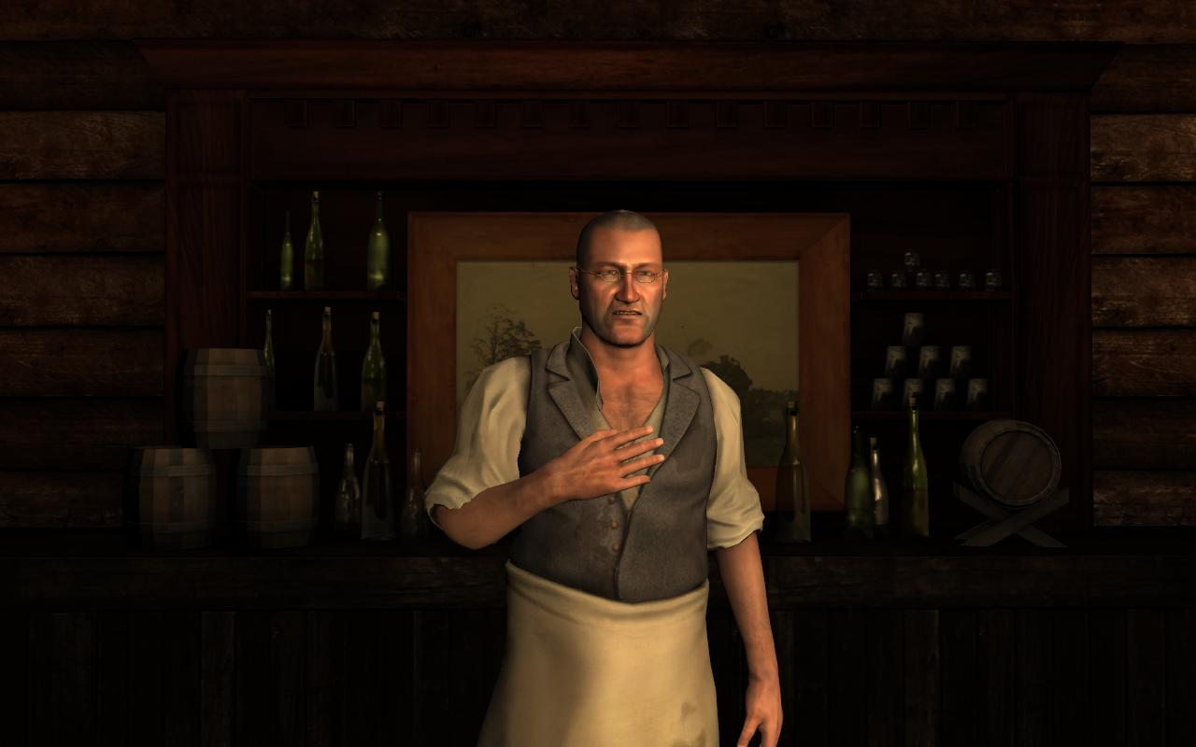
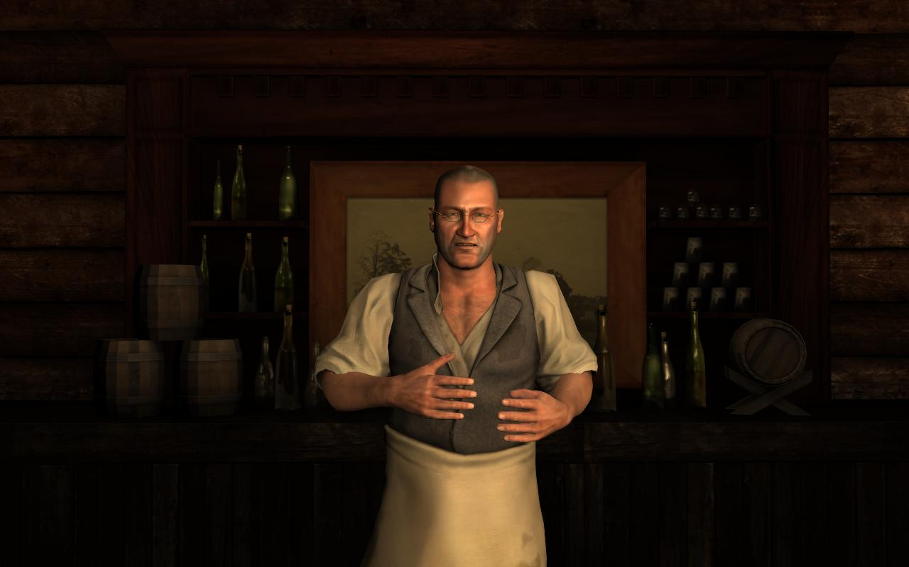
Example
Story state: utah-harmony-smalltalk
Ranger input
“What is your name?”
Facing Utah
Response
Utah: “My name is Utah. This here
is my saloon. And you are?”
State change to ranger-name
Ranger input
“I’m Jon.”
Response
Utah: “That’s a citified name if I ever heard one. I think Ranger fits you better.”
Harmony: “Ranger. Well, that sounds dangerous. Are you married, Ranger?”
State change to ranger-married

Slide 14
Design: Traditional Challenge
Tension between progress/research and fun
Application often slave to the technology and research

Slide 15
Our Approach
Fun first, AI second
User experience is central
Single participant
One time experience
Guide participants within story and keep them engaged
Two key design principles
Provide total immersion
Give illusion of control

Slide 16
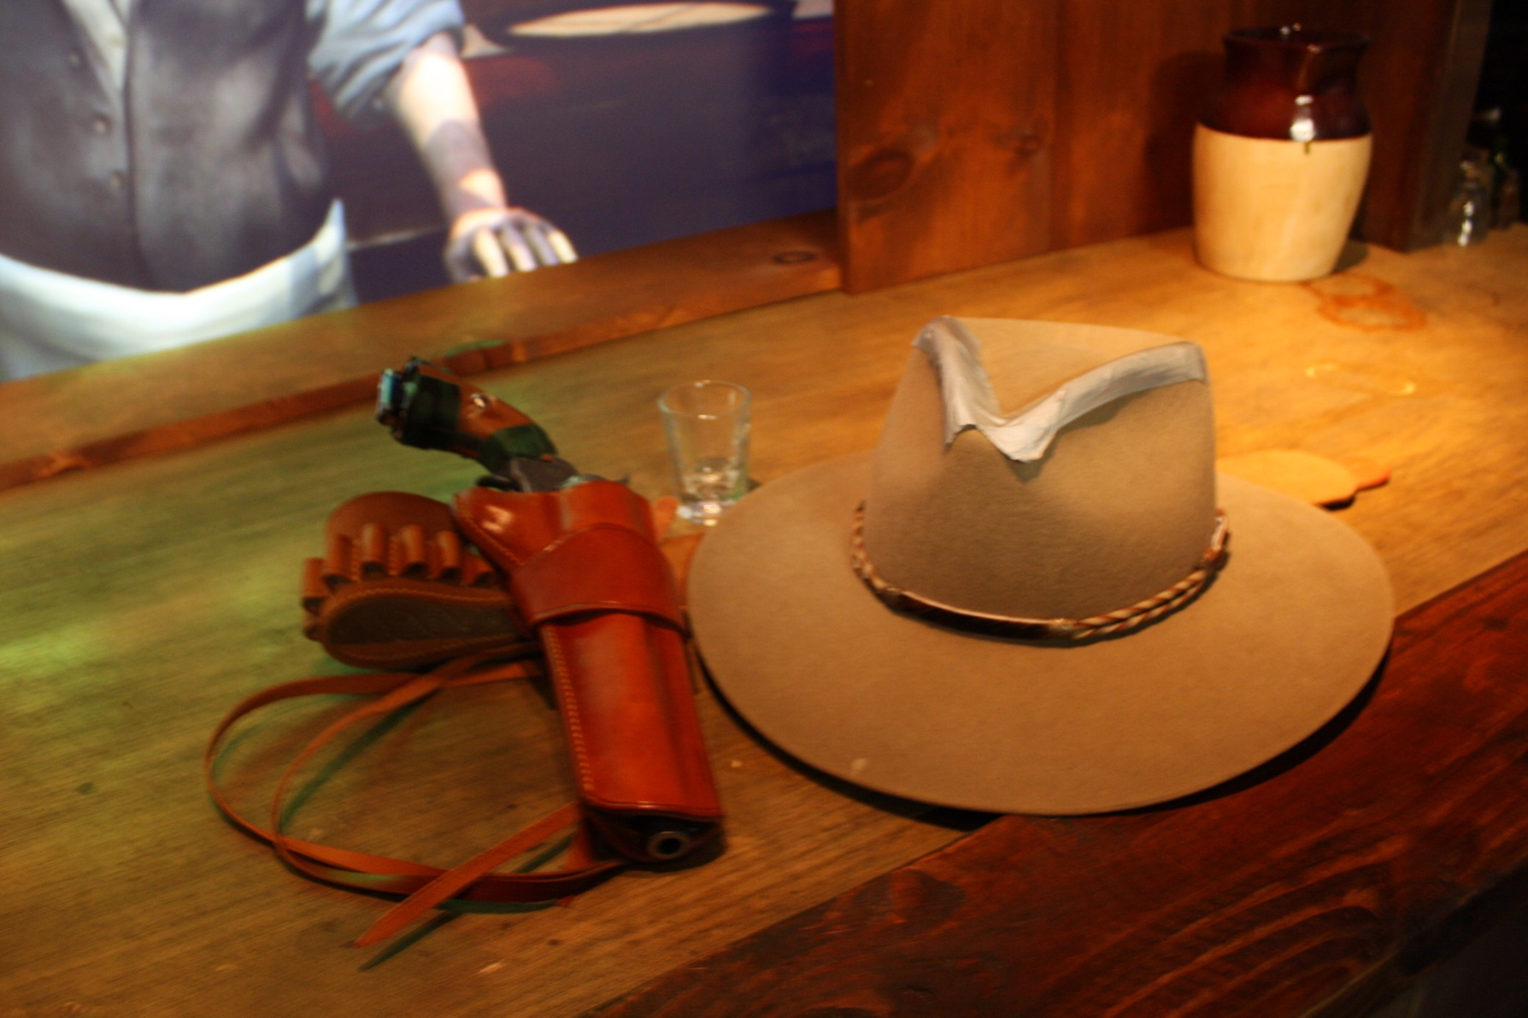
Immersion – Props
Notes:
Physical props, hat, badge, holster, gun

Slide 17
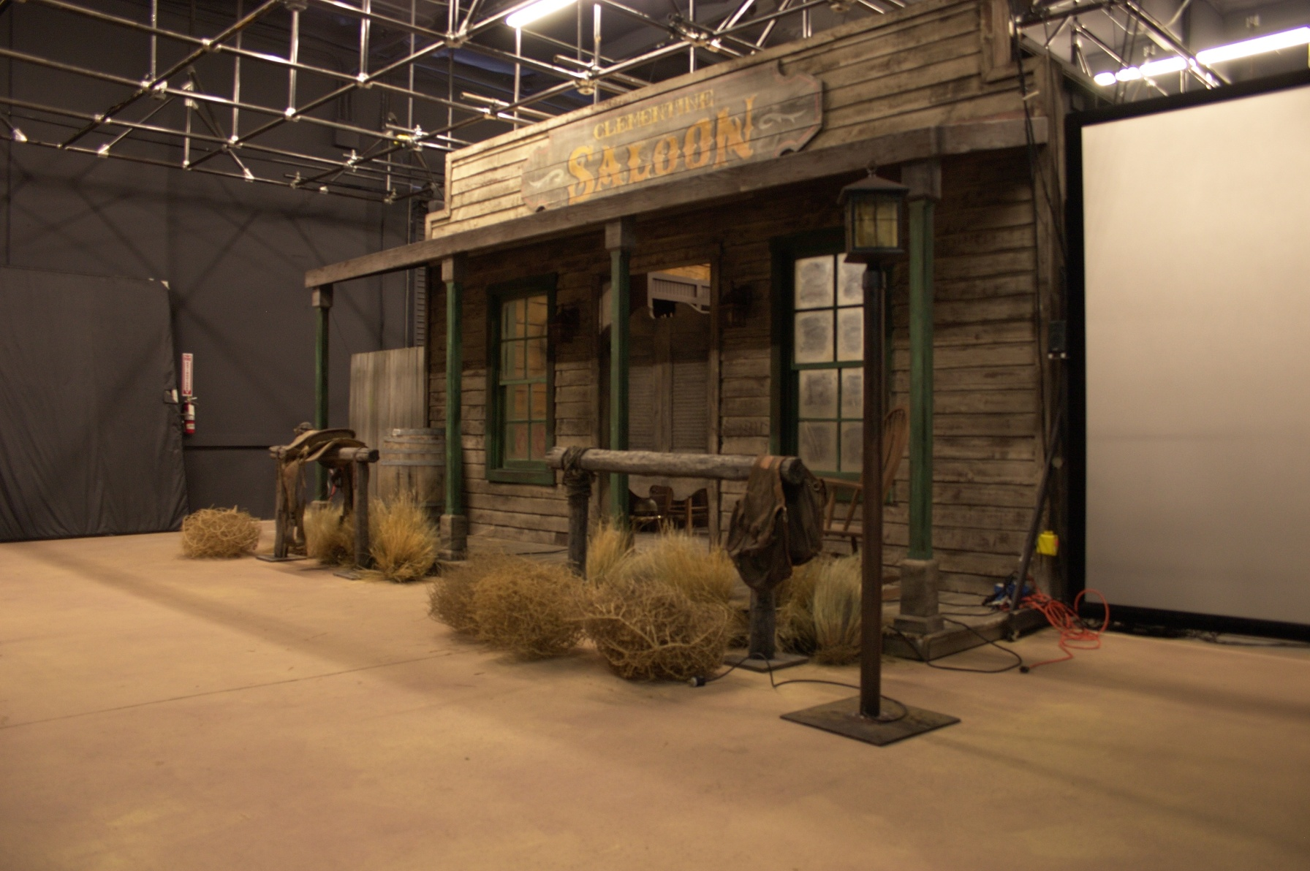
Immersion – Physical Set

Slide 18
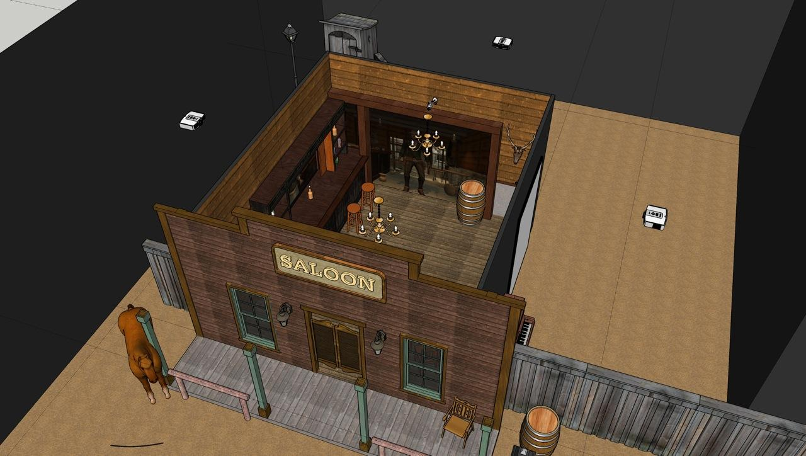
Immersion – Ease in Experience
Notes:
Prep area
Street
Kiosk
Entry
Character guidance
Open experience

Slide 19
Immersion – Story & Characters
Traditional story arc and elements
Highs and lows, flow of the story
Anticipation
Climax
Obstacles
Fleshed out characters
Background
Personality
Motivation
Feelings
Professional writer and actors

Slide 20
Immersion – Professional Creators
Writer
Set designers
Set constructor
Cinematographer
Director
Voice actors
Motion caption actors
Sound design

Slide 21
Immersion – Mood
Tense
Set at night, dramatically lit
Thunderstorm, rain, lightning
Visuals, touch, sound (maybe smell)

Slide 22
Illusion of Control
Participants need to know what to do
Participants need to feel their actions have effects and meaning

Slide 23
Illusion of Control – What to Do
Iconic genre and themes
Western
Good guy vs. bad guy
Damsel in distress
Duel
Reinforce central themes with preshow
Sets up the world and story
Introduces characters
Introduces Ranger goals
Provides hints and tips
Character guidance
Offer advice
Answer questions
Force choices

Slide 24
Illusion of Control – Actions Have Meaning
Characters always react to participant
Verbally, asking and answering questions
Nonverbally, looking at Ranger and others
Participant can interrupt characters
Verbally, depending on character state
Nonverbally, drawing gun
Mix of open ended and scripted interactions
Offer small and big choices
Inaction leads to defeat
Design for multiple personalities
Timid
Aggressive

Slide 25
Status
In mid development
Formal user studies yet to be performed
Informal feedback so far has been great
People love the real life set
Characters responding correctly to participant’s verbal and nonverbal actions is very powerful
Combination of participant and character initiative is very powerful
“I would definitely pay for this experience”
“This isn’t fun, it’s stressful!”

Slide 26
Lessons Learned
Combination of relative simple techniques can be powerful
Use of traditional story techniques useful
Participant personality important
Location of characters
Character’s attitude
Be consistent in every aspect in order to keep people engaged

Slide 27
Future Work
Multimodal fusion (speech and vision)
Modeling multi-party dynamics & gaze behaviors
Listener backchannel prediction
Facial expression recognition
Exploring social impact of emotional displays
Exploring extent users obey social norms and exhibit social effects (i.e., treat computers as people)
Data collection device to train models for recognizing/classifying/synthesizing human nonverbal behavior
Research addressee recognition and policies
Research interruption policies
Overall performance and satisfaction for PTT vs. continuous ASR

Slide 28
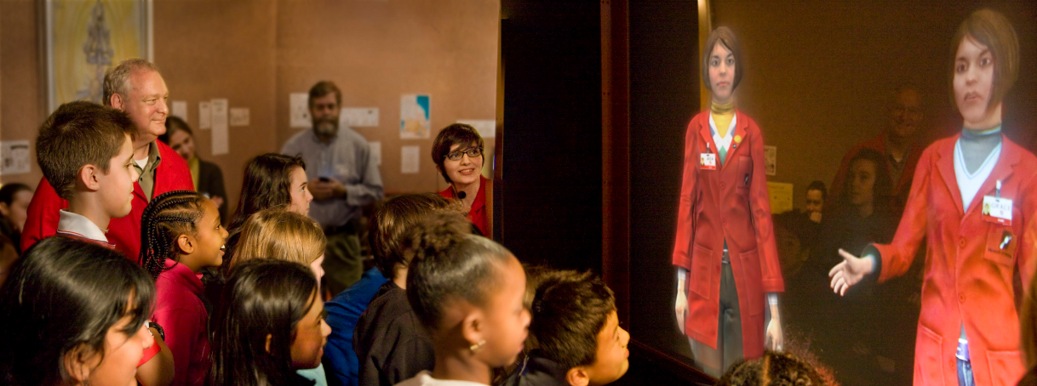
NSF Museum Guides, Boston Museum of Science
Figure 1: Visitors engaging with Ada and Grace at the Boston Museum of Science at their debut.

Slide 29
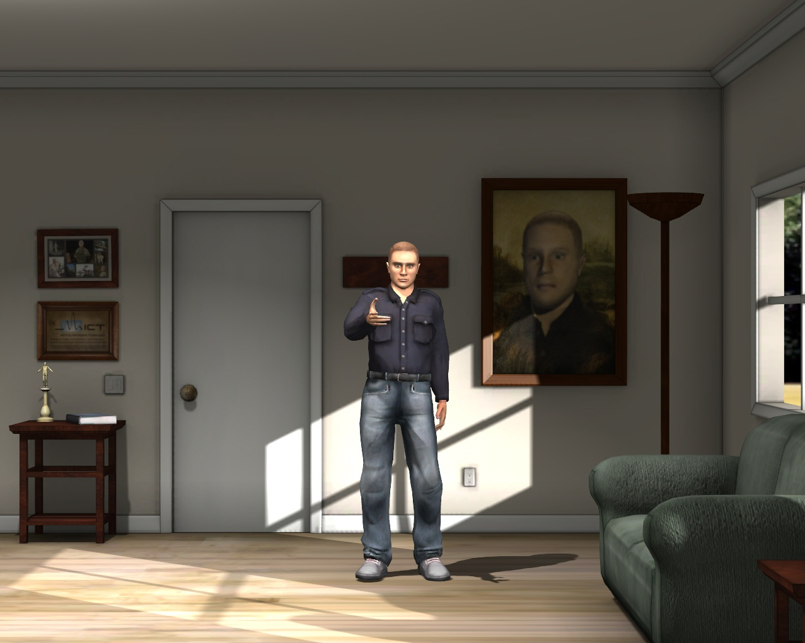
ICT Virtual Human Toolkit
Virtual Human Toolkit http://vhtoolkit.ict.usc.edu

Slide 30
Questions?
Virtual Human Toolkit: http://vhtoolkit.ict.usc.edu
Email: hartholt@ict.usc.edu

